Slide 1

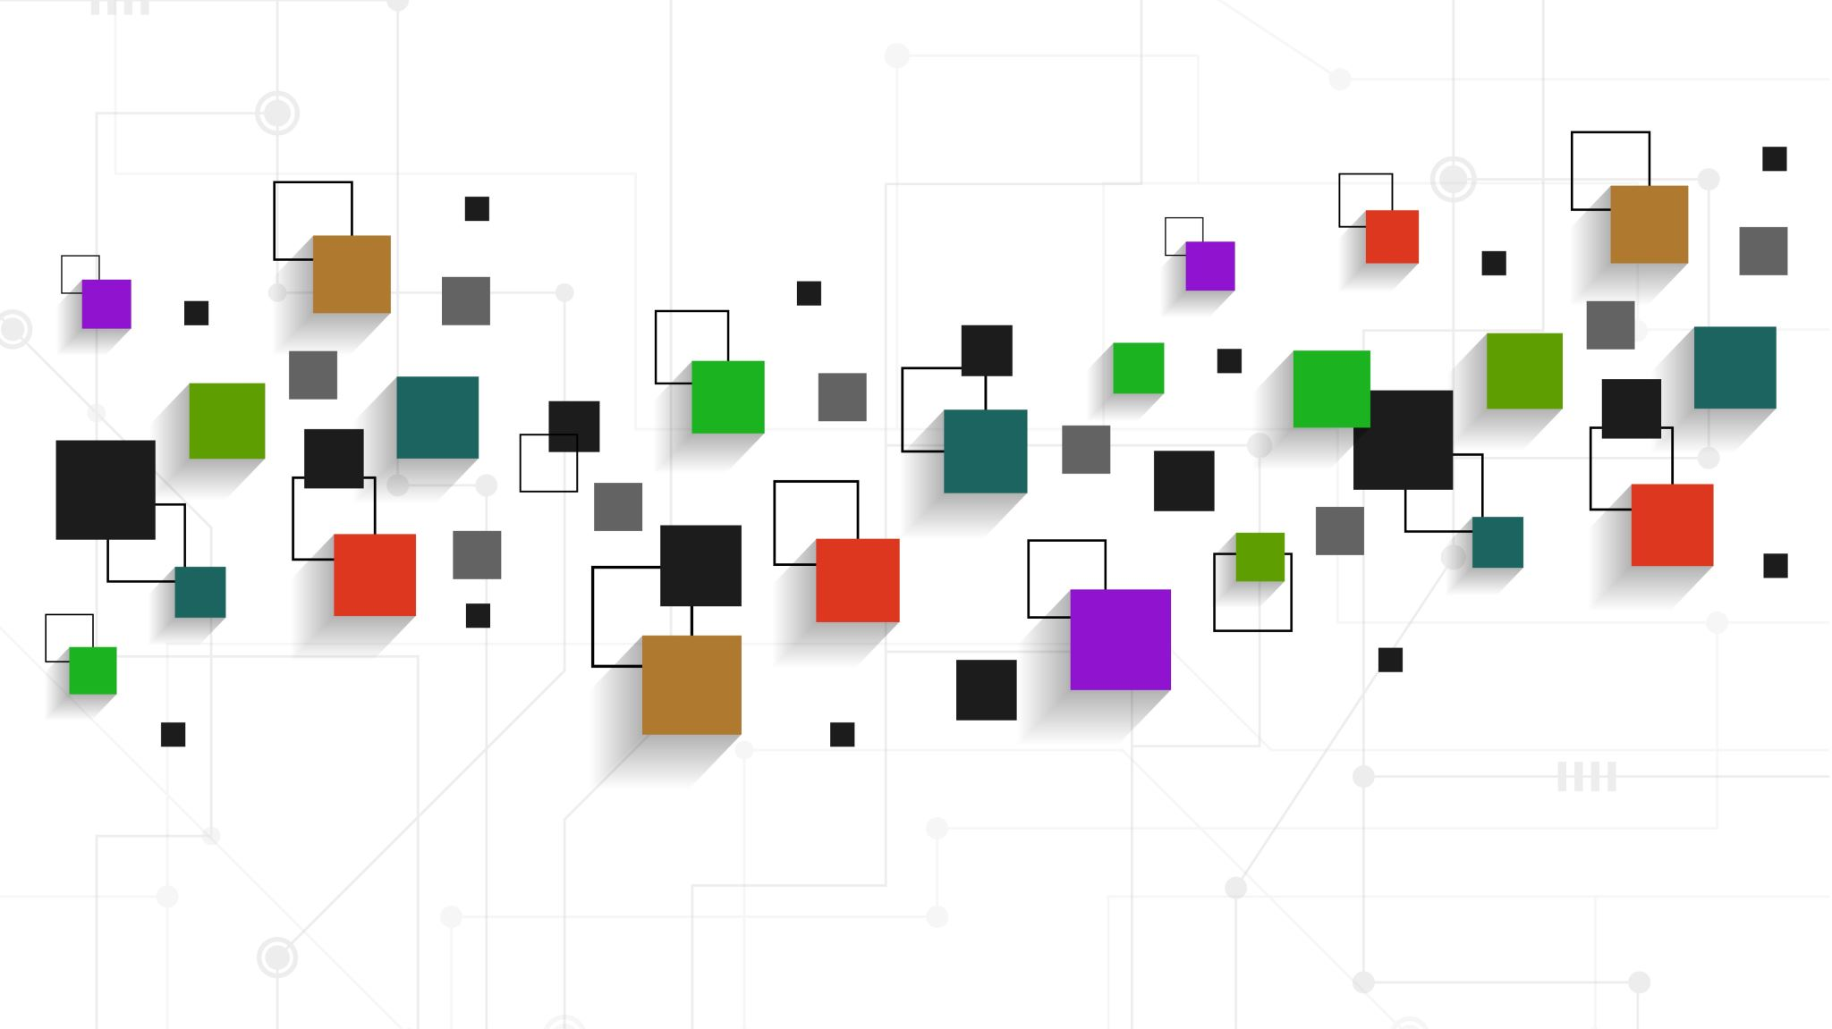
Introduction to Software Business Product Management
Week 2 Day 3
Led by: Emily Crose
for
Oakland University

Slide 2
Day 2 Recap

Slide 3

Questions From Day 2?

Slide 4
Application Programming Interfaces (APIs)
What do they do for applications?
How do they work?

Slide 5
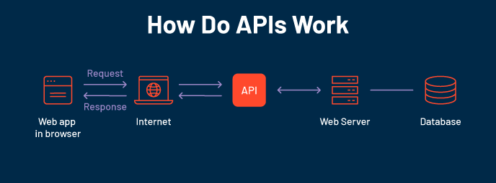

Slide 6
What is Oauth?

Slide 7
How does oauth work?

Slide 8
The software development life cycle
Notes:
Over the last couple of days, we’ve talked a lot about the types of software we may interact with in our lives. We now have a sense of scale of how large of a project it is to build an app, so the question for us becomes; how do we approach this project with as much organization as possible? That’s where the software development life cycle comes into play

Slide 9
What is the Software Development Life Cycle?
The SDLC helps us organize the process of building software
Includes steps for building, revising, and deploying software
Includes roles associated with each step along the building process

Slide 10
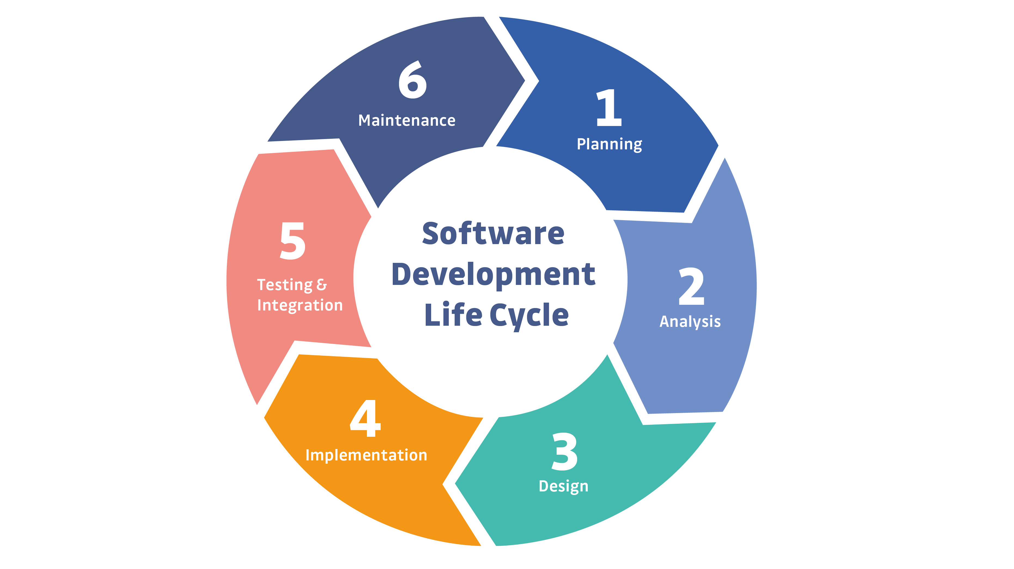
Notes:
This is a simple example of the SDLC. Typically, representations of the SDLC will have around 6 steps, but the steps will generally match what you see here.

Slide 11

Question or clarifications?

Slide 12

Questions?

Slide 13

Review Day 2

Slide 14

Preview day 3

